Slide 1
Digital Program – Temenos Jira Overview
2020-05-12

Slide 2
Contents
About JIRA
Purpose & Caveats for using Temenos Jira
Connecting to Temenos Jira
First Steps
Working Views
Hands on Exercise
CWB Jira Help Available

Slide 3
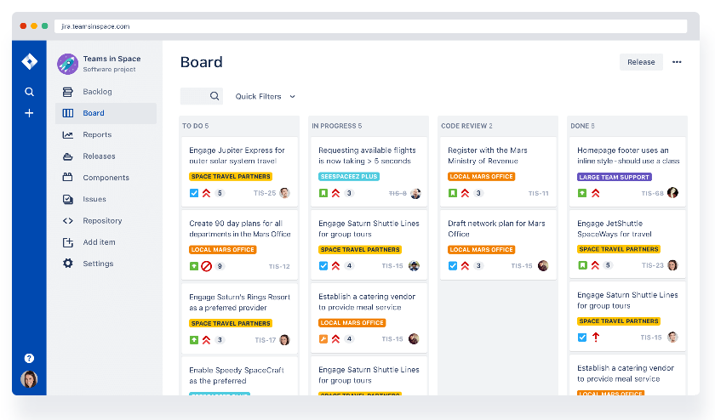
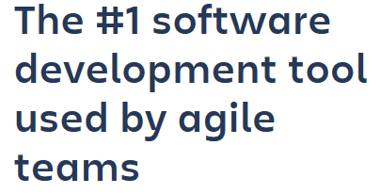
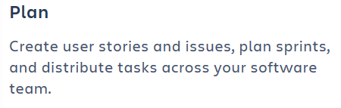
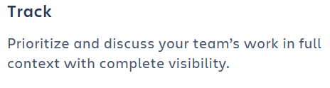
About Jira
Click for more info
“Atlassian Jira is one of the most prevalent tracking tools used in Canada.”

Slide 4
Purpose
The CWB Digital Program will be using the Temenos CWB Planning project for the purposes of planning and tracking our work across multiple partners and two major work streams (DCO, Digital Banking)
Rather than being prescriptive, the use of this project and board will evolve as the team learns, understands and optimizes Jira usage.
Add any tasks under the relevant tickets to ensure it doesn’t get lost.
Once created, a ticket can be moved from different Jira projects (like DCO and Digital Banking) or copies can be created when one ticket spans projects.
Tickets can be linked to show relationships.
Your usage and the team’s usage will grow and evolve.

Slide 5
Caveats
!
Do not place any sensitive material on Jira. This includes security issues, architecture documents, customer data, etc. Let common-sense prevail.
At the end of each project, we will extract the tickets and relevant information as project artifacts.
Not all information will be saved, attachments for example.
You will be driven crazy by all the views, options, functionality, etc. that Jira has to offer. And amazed too.
!

Slide 6
Connecting to Temenos Jira
Click to Connect
Temenos Jira URL
https://support.avoka.com/tickets/login.jsp?
Access has been granted to the following CWB team members
Adam Skoreyko <Adam.Skoreyko@cwbank.com>
Adrian Crisp <Adrian.Crisp@cwbank.com>
Alka Patnaik <Alka.Patnaik@cwbank.com>
Andrew Petesky <Andrew.Petesky@cwbank.com>
Brad Miller <Brad.Miller@cwbank.com>
Brian Coghlan <Brian.Coghlan@cwbank.com>
Candyse Watkinson <Candyse.Watkinson@cwbank.com>
Charlotte Morgan <Charlotte.Morgan@cwbank.com>
Chix Dela Luna <Chix.DelaLuna@cwbank.com>
Dino Noce <Dino.Noce@cwbank.com>
Efosa Okonkwo <Efosa.Okonkwo@cwbank.com>
Genevieve Parrent <Genevieve.Parrent@cwbank.com>
Jogi Nijjar <Jogi.Nijjar@cwbank.com>
Kate Jekabson <Kate.Jekabson@cwbank.com>
Keith King <Keith.King@cwbank.com>
Kelvin Fernando <Kelvin.Fernando@cwbank.com>
Lisa Rindero <Lisa.Rindero@cwbank.com>
Lorraine McLeod <Lorraine.McLeod@cwbank.com>
Mark Doubinin <Mark.Doubinin@cwbank.com>
Peter Olise <Peter.Olise@cwbank.com>
Reinhardt Tonn <Reinhardt.Tonn@cwbank.com>
Roney Simon Mathews <Roney.SimonMathews@cwbank.com>
Sandra Murillo Paz <Sandra.MurilloPaz@cwbank.com>
Stacy Schmidt <Stacy.Schmidt@cwbank.com>
Steve Kelcher <Steve.Kelcher@cwbank.com>
Sunil Prashar <Sunil.Prashar@cwbank.com>
Susan Bako <Susan.Bako@cwbank.com>
Vishwadeep Kauravlla <Vishwadeep.Kauravlla@cwbank.com>
Let Genevieve (Genevieve.Parrent@cwbank.com) know if you or another team member needs to be added

Slide 7
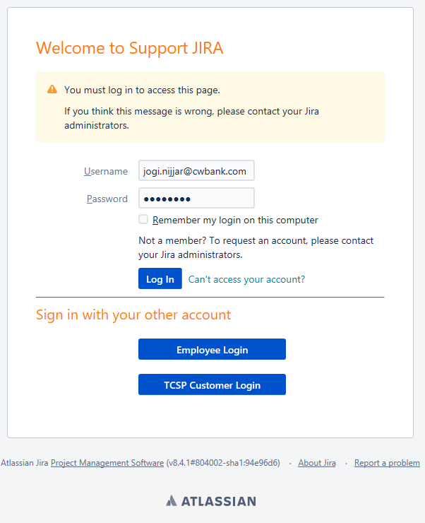
Connecting to Temenos Jira
User Name is your CWB email address like:
FirstName.LastName@cwbank.com
Password is set on first access, following the link the Jira sends to you when you are added. It is not your CWB login password.
If you forget your password, or the initial email link doesn’t work, you can use the “Can’t access your account?” function to reset your password. This reset email can end up in your spam folder or, if you have created a rule to move Jira emails to a specific folder, this reset email may end up there.

Slide 8
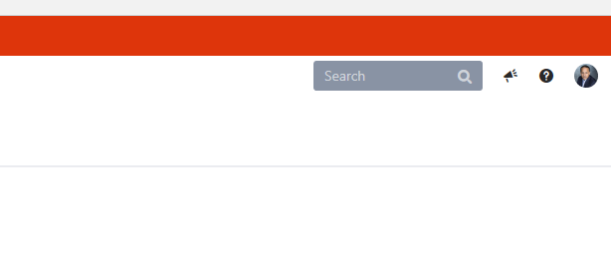
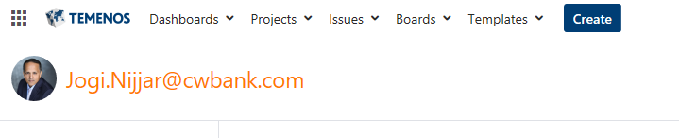
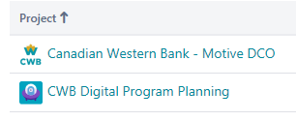
First steps
Set your avatar
Click the avatar icon in the top right hand corner.
Click “Profile”.
Click “Avatar”.
Set an avatar or upload your photo.
Once set, please try not to change
Why: when the team is reviewing the projects and boards, it is easier, at a glance, to see who the ticket is currently assigned to. If you change your avatar often, it defeats this purpose.
Ensure you have access to the CWB Planning project
Click “Projects”.
Click “View All Projects”.
You should see the following projects:

Slide 9
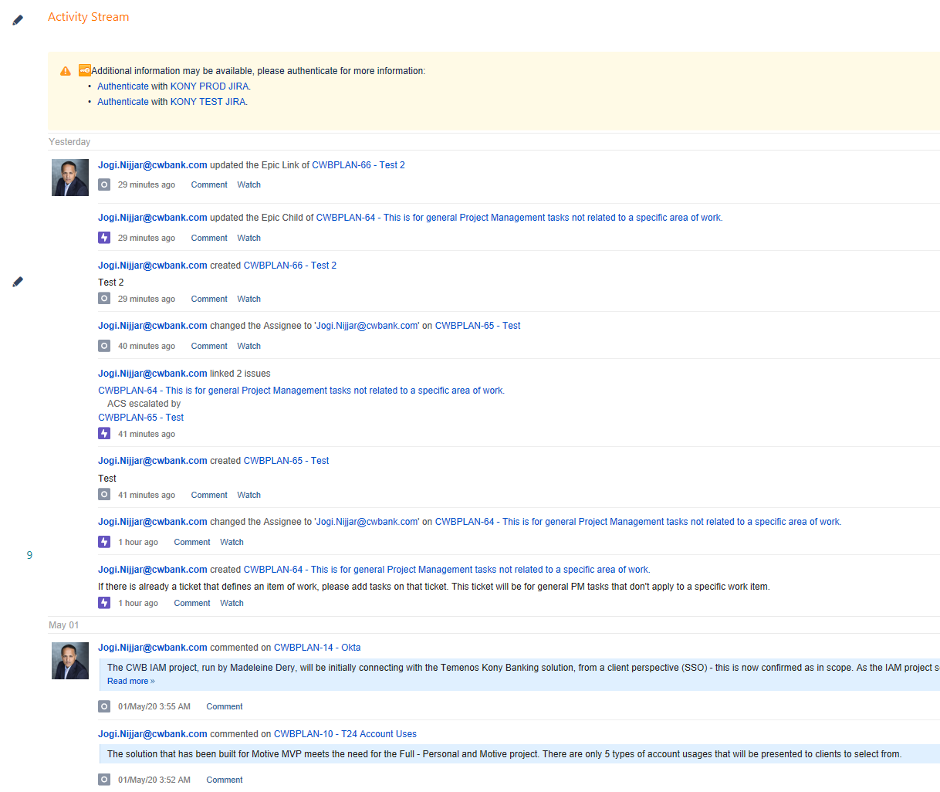
First steps
Note to self, my avatar tracks all…
If you can’t find that ticket you created or update, it is all tracked as a stream under your avatar.
Just Click you avatar.
Click “Profile”
Here you will see a stream of your Jira updates

Slide 10
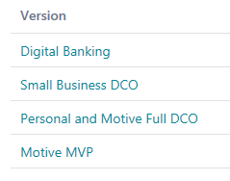
First steps
Relationships
The “CWB Digital Planning Project” has four releases:
  Digital Banking
  Small Business DCO
  Personal and Motive Full DCO
  Motive MVP
We can move tickets between these releases, or create copies, or link.

Slide 11

Working views
There are two main views you will see:
Backlog
Kanban
Some may prefer the “Issues” view.
Note: Jira was originally a bug tracking systems which is why you will see the term “issues” refer to an item. Now an item can be of type: issue, task, etc.
If you ever get lost, can’t remove filters, etc., just go back to the basics:
Click “Projects”.
Click “View All Projects”.
Start again
Backlog
Kanban
Issues

Slide 12
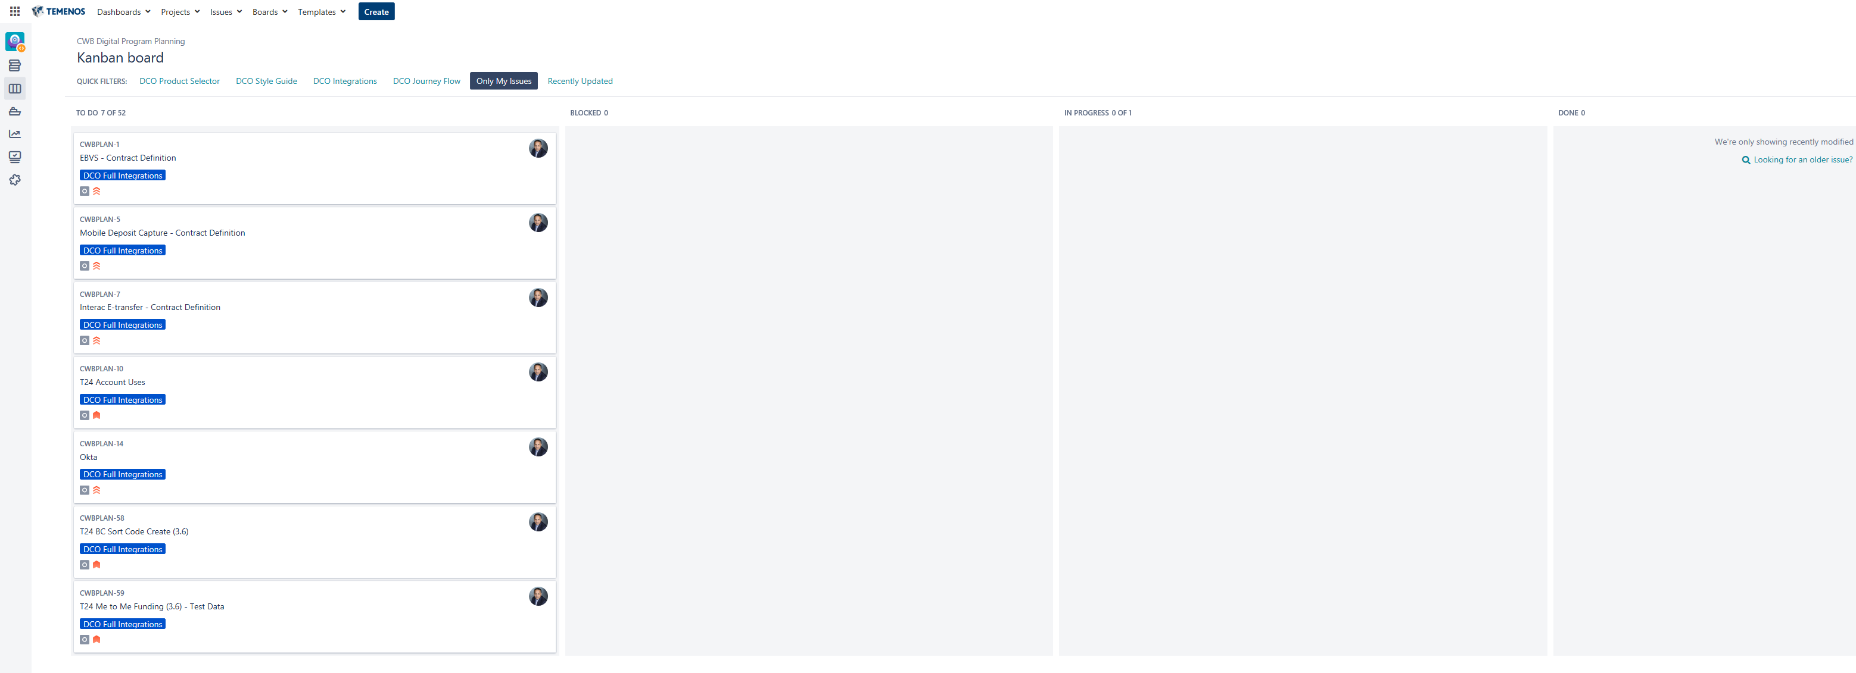
Working views: Kanban & Assigned to Me
Where most of you will live your life…while on the Digital Program

Slide 13
Hands On
Please Remember
If you try all use all the bells and whistles in Jira…you will lose your mind. Please avoid both.
Stick with the basics, when you are lost:
  Click “Projects”.
  Click “View All Projects”.
  Click “CWB Digital Program Planning” project.
  Click “Kanban board”.
  Click “Only My Issues”.

Slide 14
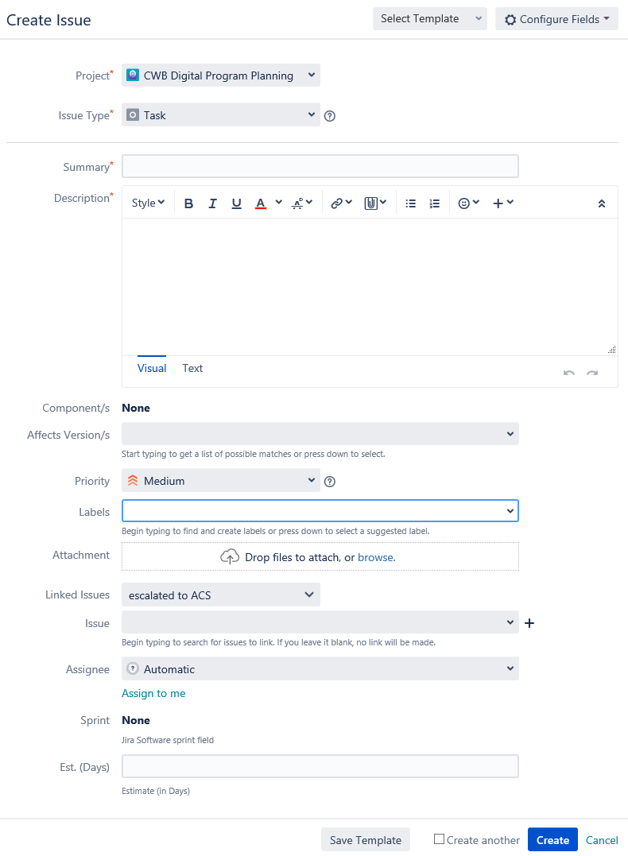
Hands On – In Class Assignment
Create a new Tasks, calling it “Test – [insert your first name here]
Click “Create”. There are many ways to create a new ticket.
Minimal fields to fill out:
  Check its assigned to the right project
  Check it’s the right issue type – task mostly
    No type = “issues” please
  Summary (aka title)
  Description, be informative
  Affects Versions
  Priority
  Assignee – by default it’s blank
  Severity (note: Temenos is working to expose this)
  Due Date (note: Temenos is working to expose this)

Slide 15
Hands On – In Class Assignment
Filters and Queries are your friends
There is a multitude of ways to search and report on work in progress
Bonus assignment: Show all tickets that Jogi hasn’t touched in the last 5 days that were assigned to him over 10 days ago. Sort by priority. Just kidding, no need to search.

Slide 16
Our Jira Help
Online Help
Remember, Jira is a complicated piece of software, no one knows it all. That said, here are some folks willing to help:
  Adrian Crisp
  Susan Bako
  Sunil Prashar
  Steve Kelcher
  Chix Dela Luna
  Jogi Nijjar

Slide 17
To Add
Update PPT Slides: History of a ticket & audit log Search for all Issues Adding custom filters and personal dashboard | Jogi with assistance from Sunil/Steve

